Slide 1
Predicting Boston Housing attributes using Data Science Models
By: Tanmay & Kofi

Slide 2








Slide 3
Research Question: Based on the crime, age of a home, access to highways, and the 11 other attributes how well can our logistics regression model, SVM, and K-means predict the attributes and value of the home.
Potential Solution: A potential solution is to use our static models to validate whether there is a correlation in the price of a house and the features of its city/town. Are residents willing to pay more for a home with better levels of oxygen (Nox variable) or for areas where the teacher pupil ratio is low. Using KNN, linear regression and SVM we’ll dive into the data for attributes that are highly correlated to determine how well we can predict the attributes of a Boston home based on the housing price.

Slide 4
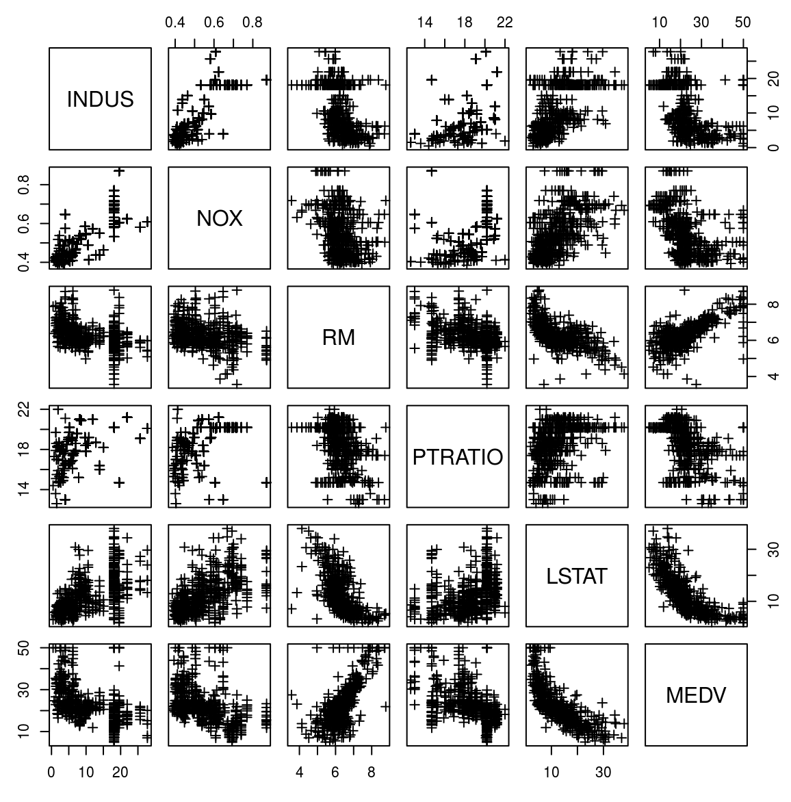
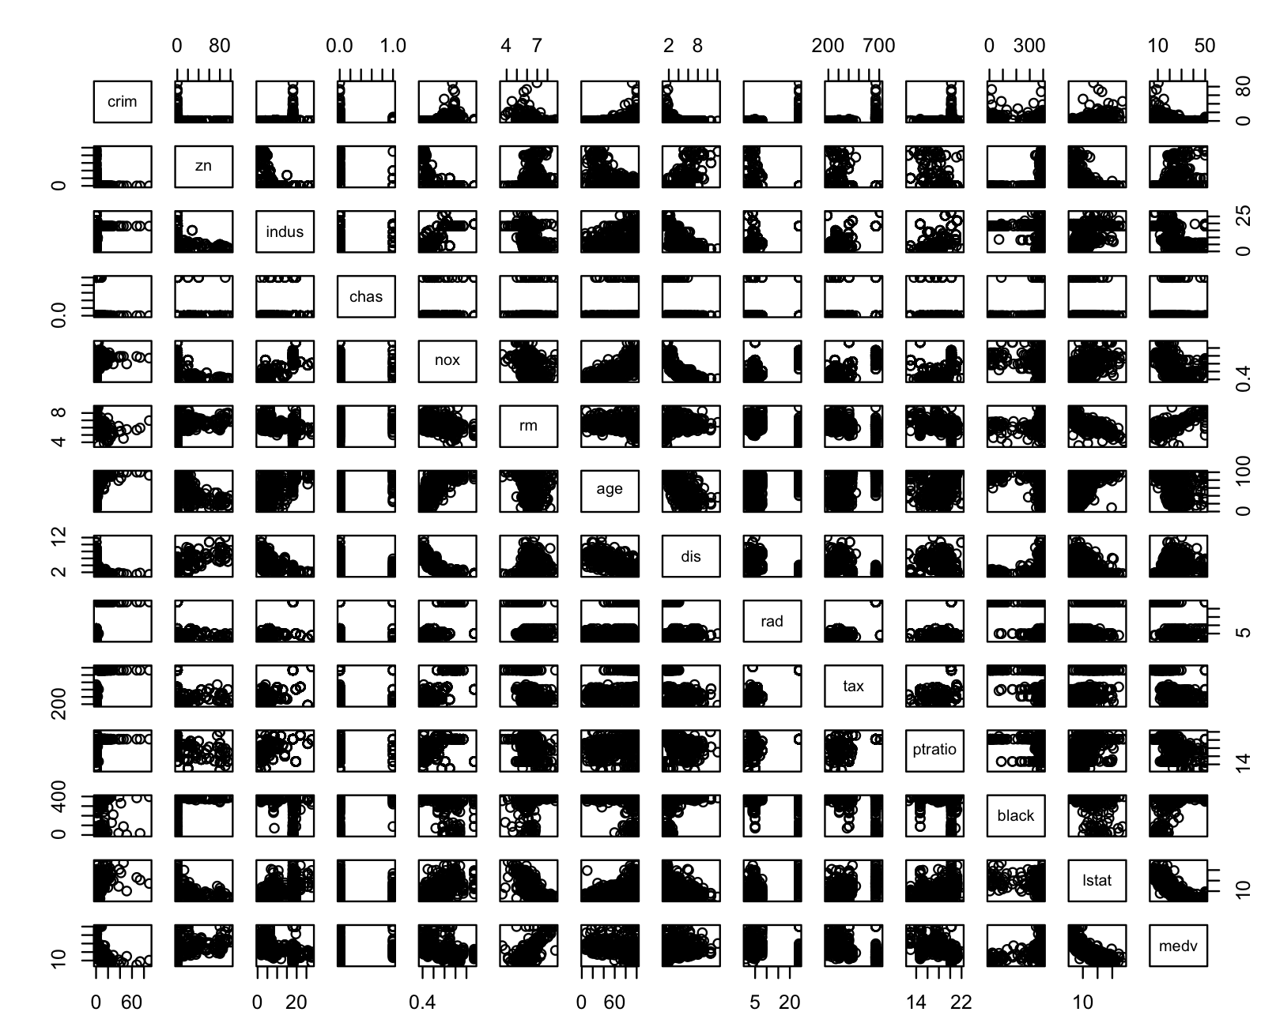
Data Visualization

Slide 5
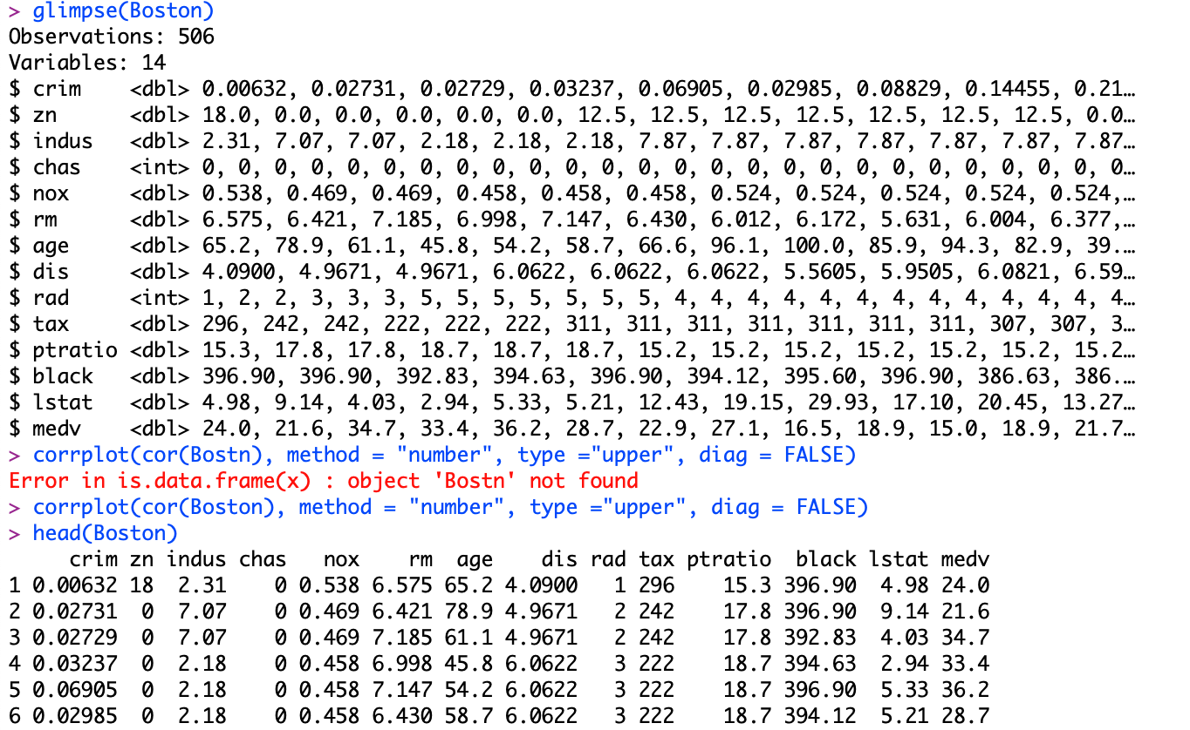
Data
506 Observations
14 Variables
Training
80% of data
404 Rows
Test
20% of data
102 Rows

Slide 6
Variables Evaluated
City Characteristics
ZN – Proportion of residential land zoned for lost over 25,000 sqft *
RAD – index of accessibility to radial highways*
CRIM – per capita crime rate by town
DIS -weighted distances to five Boston employment centers*
INDUS – the proportion of non-retail business acres per town
PTRATIO – pupil-teacher ratio by town*
Characteristics
Age – the proportion of owner-occupied units built prior to 1940
RM- the average number of homes*
TAX – full value property tax rate per $10,000*
Medv – Median value of owner-occupied homes in $10,000*
Demographic Characteristics
B – 1000(Bk – 0.63)^2 where Bk is the proportion of blacks by town*
LSTAT - % lower status of the population*
Predictor characteristics
CHAS – Charles river dummy variable*
NOX – nitric oxides concentration (parts per million) *

Slide 7
Models Evaluated
SVM
Used R library (e1071) for svm function
Model parameterized by mean of medv
Radial and Linear kernel models were fit.
Model parameters were tuned using the “caret” package
Model variable created from linear model
KNN
Used library (class) for knn function
Model variables informed from logistic model.
Model parameters were tuned using the “caret package
Optimal model was found by RMSE (Root Mean Square Error)
Linear Regression
lm() function is inbuilt in R and no package is required.
regsubsets() function used to find best subset of 13 explanatory variables.
Model is tuned using backward, and forward selection

Slide 8
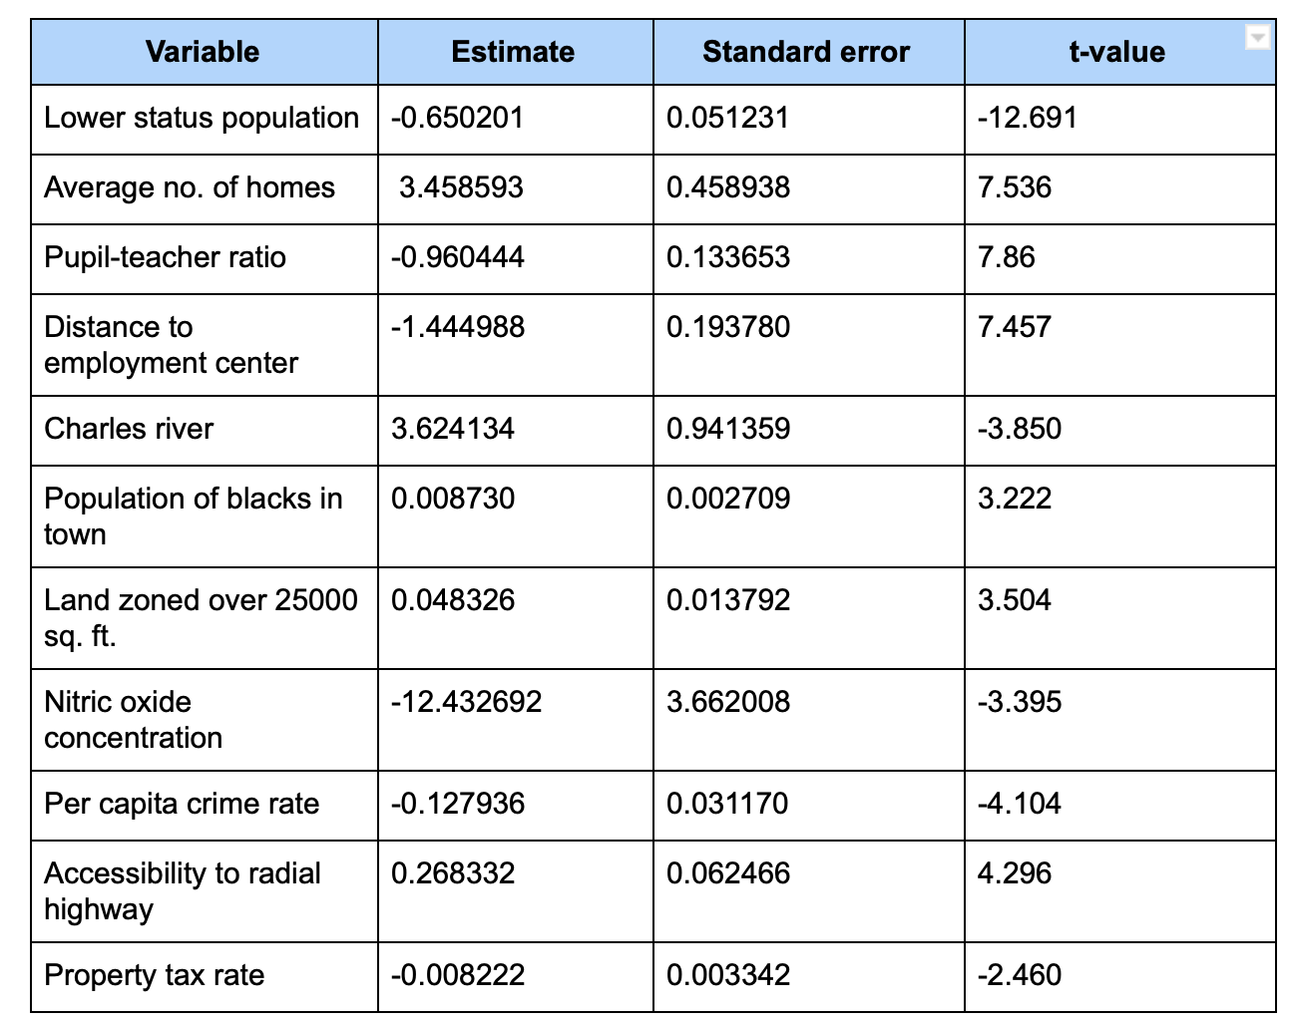
Linear Regression Model
Interpretation: T values that are further away from 0 positively and negatively indicate that there is a relationship exist among the data fields.
The t-values confirms the relationships the models identified as having a strong attribute to house values and conditions.
The Standard error can be interpreted as the distance our variables fall from the regression line. Significant variables that are close to the regression line are the populations of blacks in town and crime rate.

Slide 9
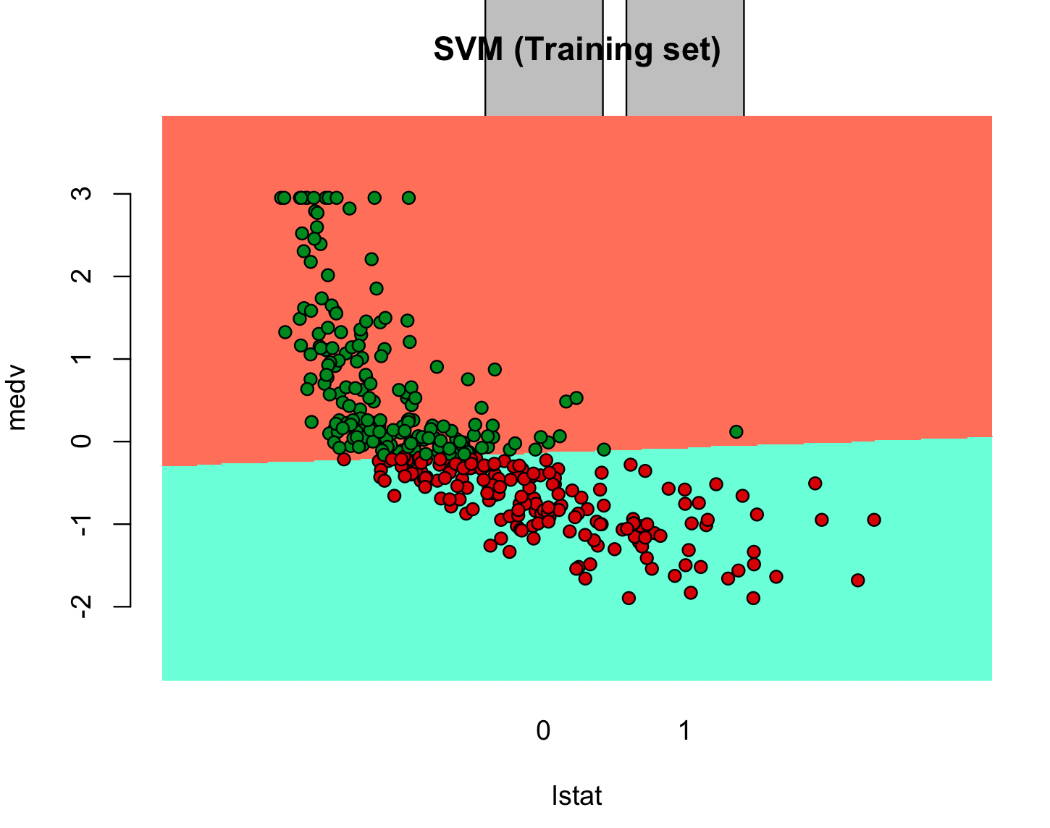
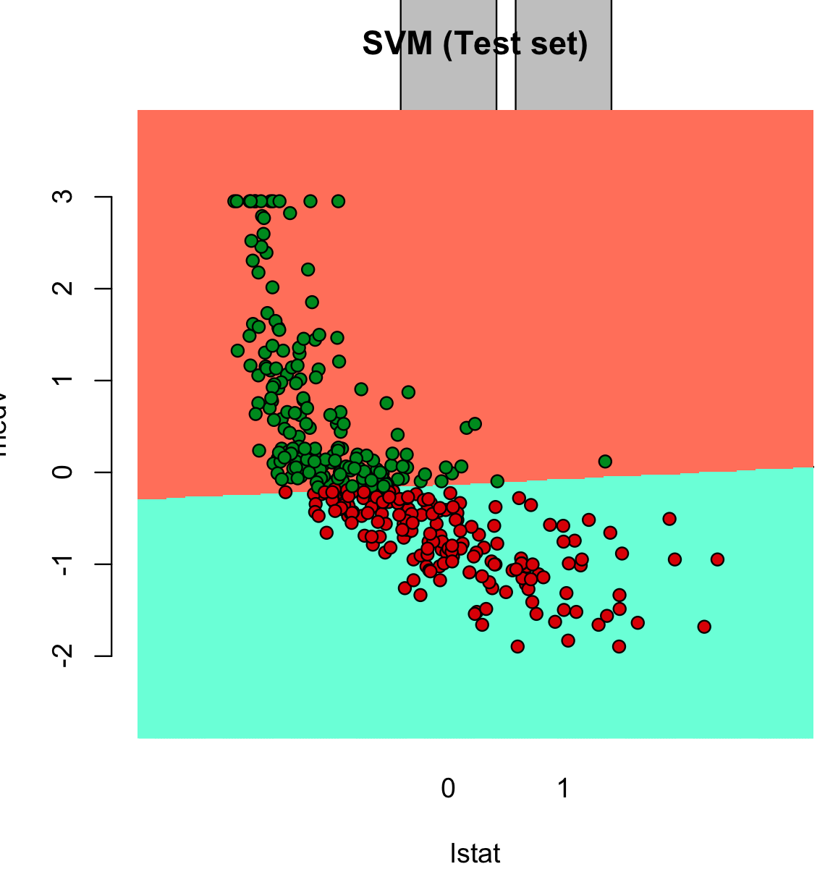
SVM Linear Kernel
We fit the medv and lstat data on SVM by finding the best hyperplane that differentiates the data.
The data is segregated based on the mean of medv and values of lstat are trained and tested to categorize the data.
This we did for classification.

Slide 10
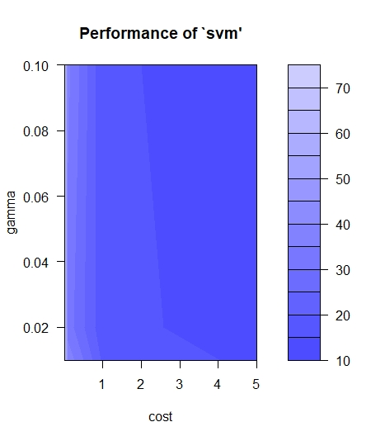
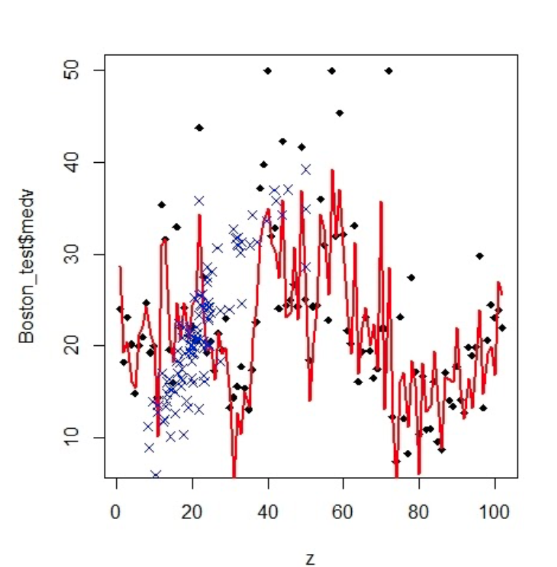
SVM Radial Kernel
SVM model fits a margin around the hyperplane and then predicts the values.
The Parameters are tuned to predict the value of medv on our data.
The red line in the bottom graph shows the variation of our predicted values to the actual values in our data.
We find the number of support vectors with 206 support vectors and sampling with 10-fold cross validation
Our SVM improves when we fine tune our parameters with 269 support vectors which provides us with a lower gamma.
It's evident that the radial kernel is better than the Linear as it fits more data attributes.
Optimal model had a gamma of 0.1 and a cost of 5

Slide 11
KNN
 | Actual | Predictors
Actual | 1.00 | .88
Predictors | .88 | 1.00
K Nearest neighbors was sampled with 404 samples and 13 predictors and a knn= 5 was chosen
Tuning of data was done by training our model using ‘train’ in caret library
RMSE was also used to select the best K
K | RMSE | R-squared | MAE
5 | 5.07 | .718 | 3.21
7 | 5.09 | .719 | 3.23
9 | 5.07 | .729 | 3.23

Slide 12
Model Comparison
Model | MSE | RMSE | Correlation accuracy
Linear Regression | 23.44 | 4.84 | 80%
LInear SVM | 23 | 4.8 | 86.3%
Radial SVM | 8.4 | 2.9 | 92.56%
KNN | 19.7 | 4.4 | 88%
All the models performed adequately well with an accuracy above 70%, the Linear Regression model was not a go predictor in using the mean to split the data. However the Radial SVM performed the best with an accuracy of 92.56%

Slide 13
Limitations of Data
The data did not include details on all demographics in the Boston area
Predictive models could have been improved with more details on city characteristics and employment data.
The Boston data set is not current and economic and housing factors may have changed

Slide 14
Conclusion
The goal of this report was to determine the neighborhood attributes that best explained variation in house pricing. Various statistical techniques were used to eliminate predictors and extraneous observations. In examining the final model, one finds – quite reasonably – that house prices are higher in areas with lower crime and lower pupil-teacher ratios. House prices also tend to be higher closer to the Charles River, and houses with more rooms are pricier. This report is interested in the neighborhood attributes of houses, so the number of rooms is not an important predictor. The most interesting factors to consider are nitrogen oxide levels and distance to the main employment centers.
On a concluding note, it is important to note that the data for this report was collected several decades ago. In the years since, there is no doubt that pollution levels have risen and it would be interesting to examine the ways in which that affects house pricing in Boston today.

